Slide 1





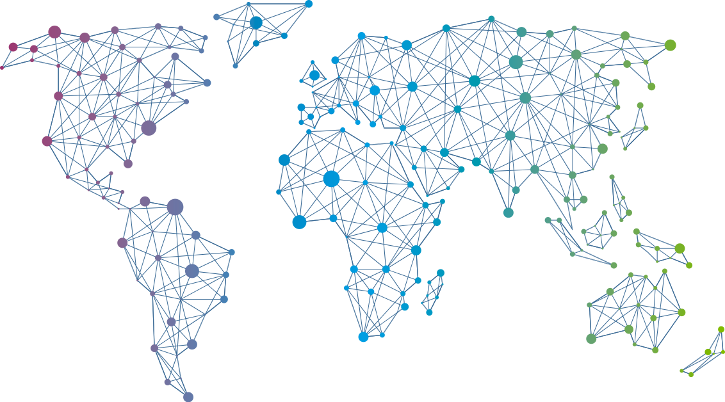

Speaker
Debabrata Panigrahi
New paradigm of resiliency testing: Cloud Native Chaos Engineering
Debabrata Panigrahi
debaelopedev
September 16th & 17th
^{Online Event}
Powered By
International Conference

